Slide 1
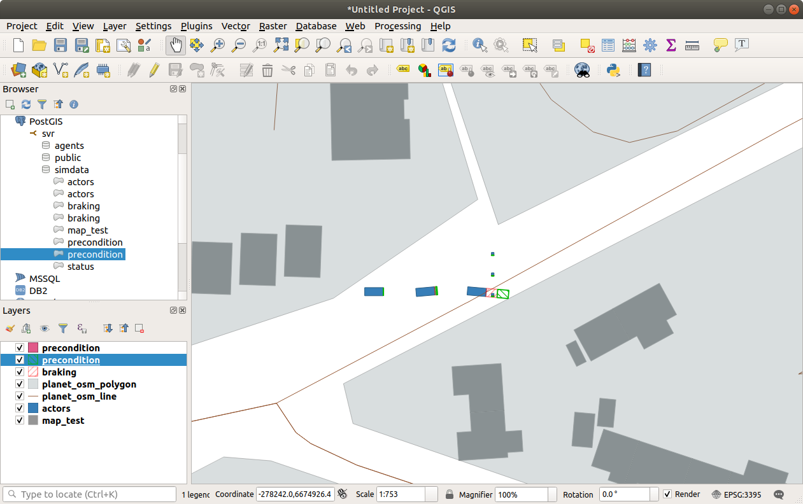
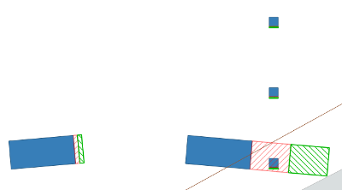
Pedestrian
AV

Slide 2
Thinking Distance
Braking Distance
Local Buildings
Pedestrian
AV
Road Network

Slide 3
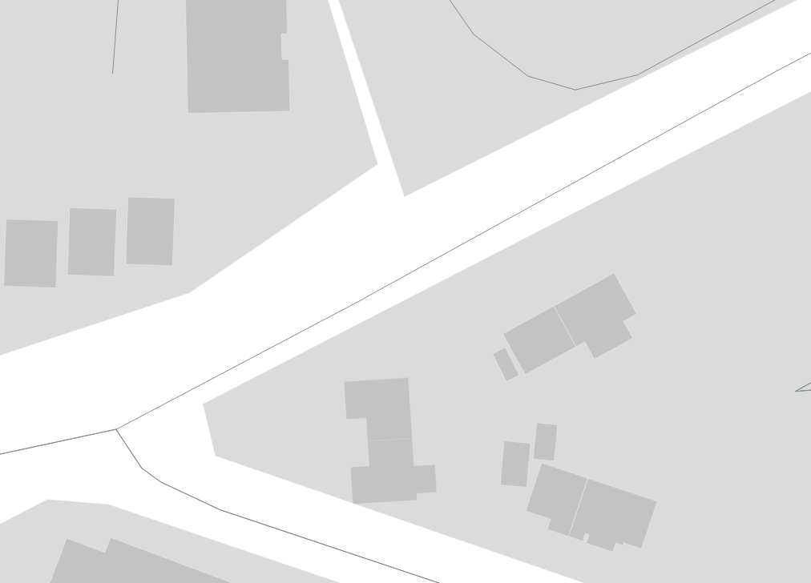
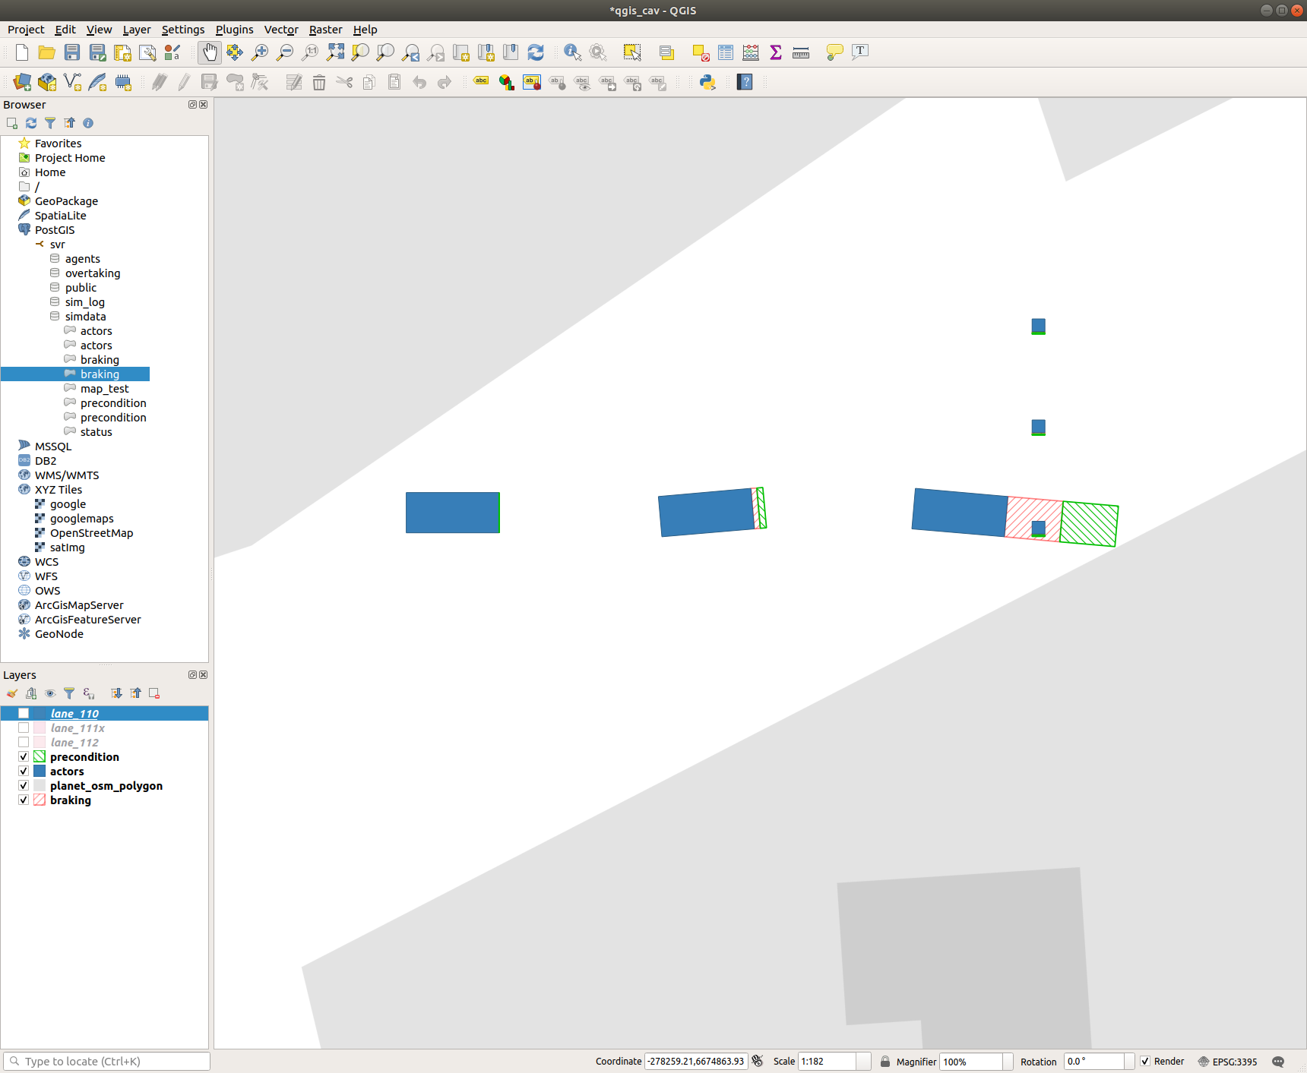
Thinking Distance
Braking Distance
Local Buildings
Pedestrian
AV
Road Network

Slide 4
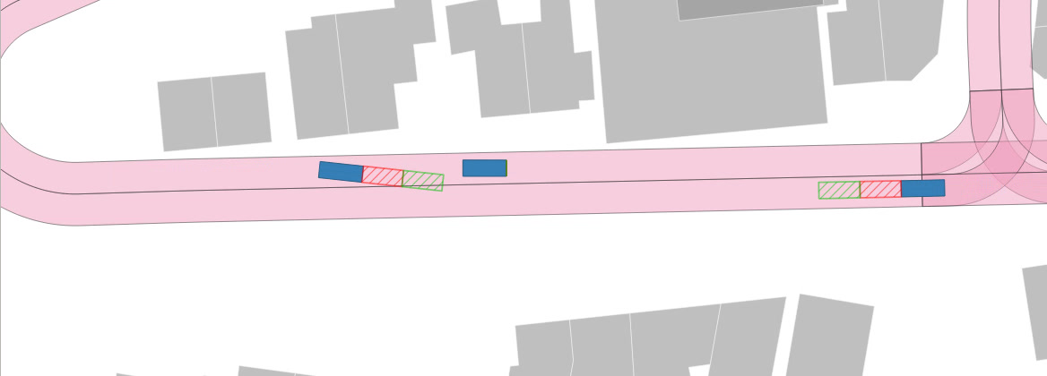
Local Buildings
Thinking Distance
Parked Vehicle
Braking Distance
Oncoming Vehicle
Road Network
AV

Slide 5
Local Buildings
Vehicle Being Passed (VBP)
Lanelets
Thinking Distance
Oncoming Vehicle
Braking Distance
AV
INSET
Distance Ahead

Slide 6
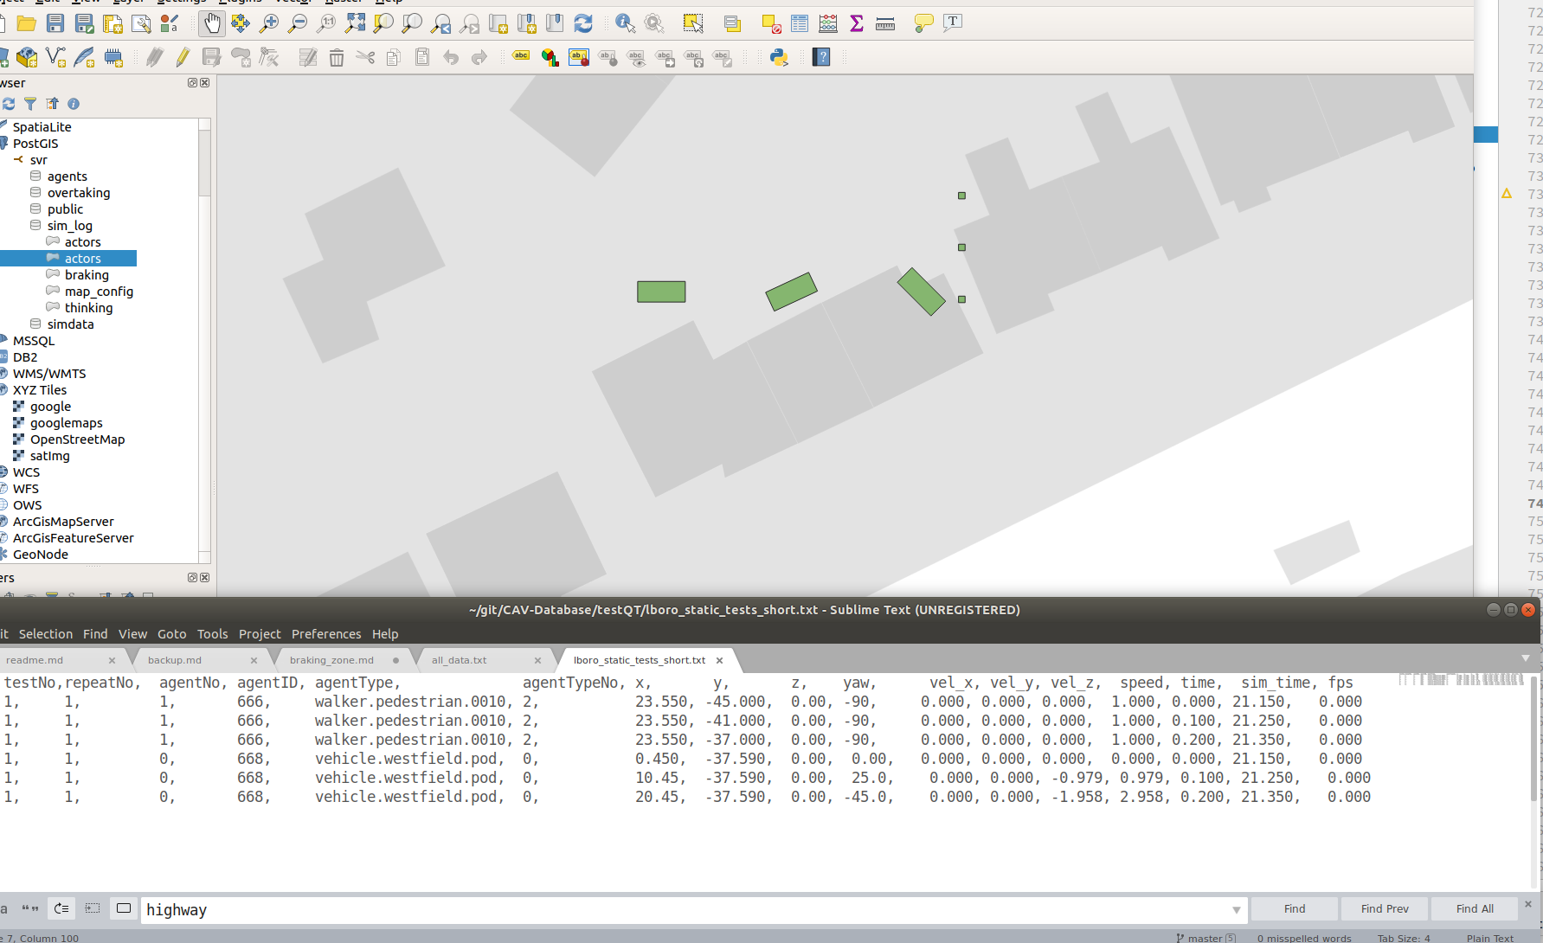
0deg
25deg
-45deg
Downend Road

Slide 7
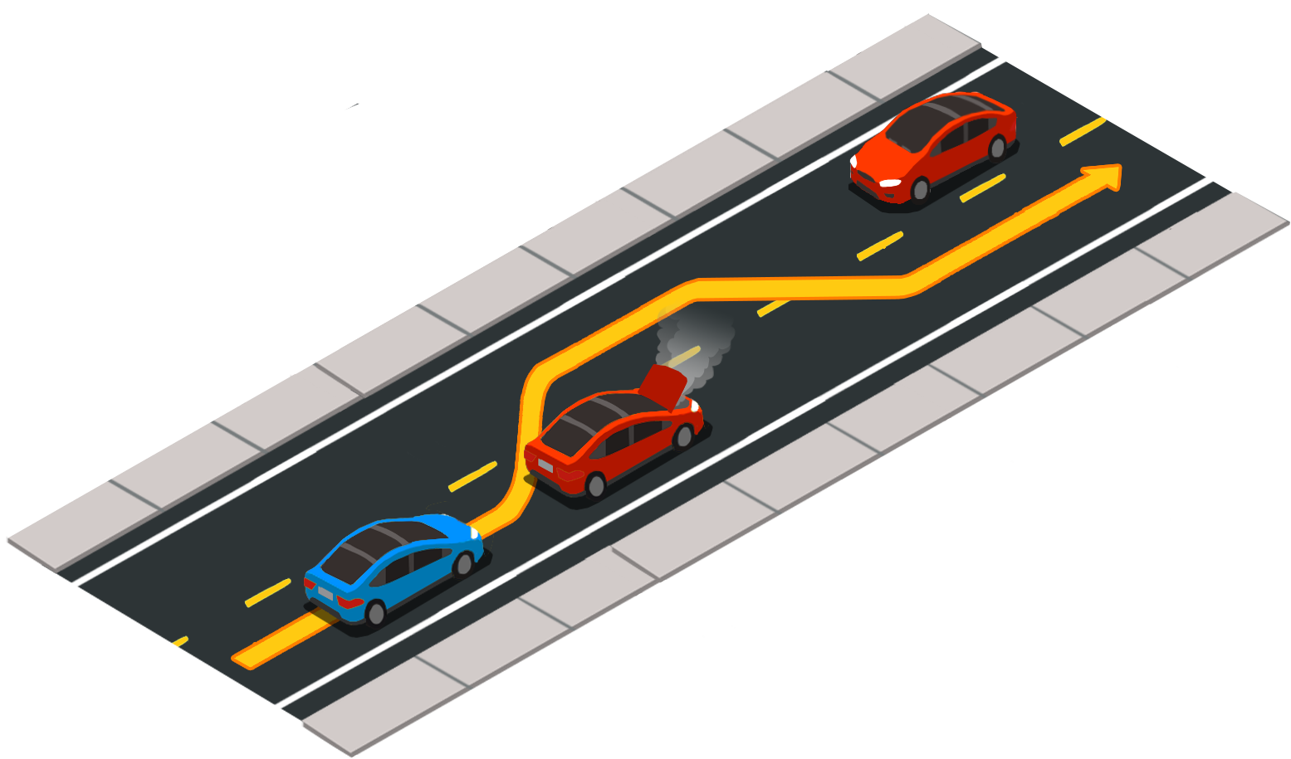

Slide 8
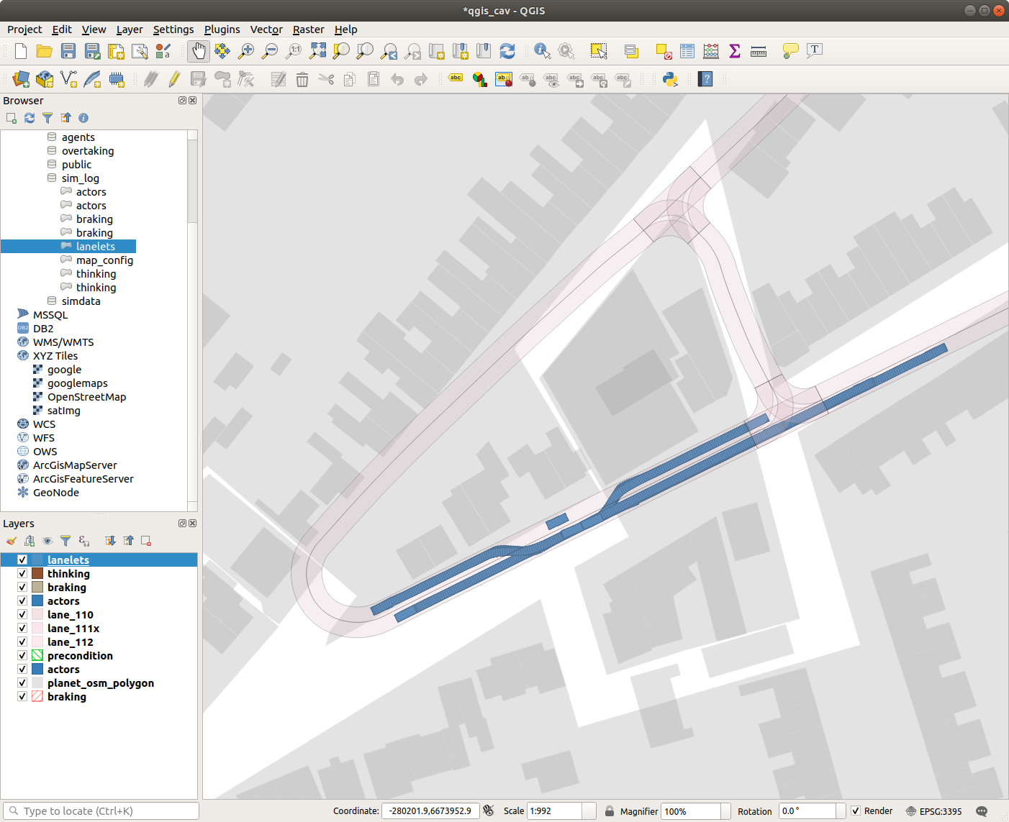
Buildings
Lanelet
Parked vehicle
Ego vehicle
Oncoming vehicle

Slide 9
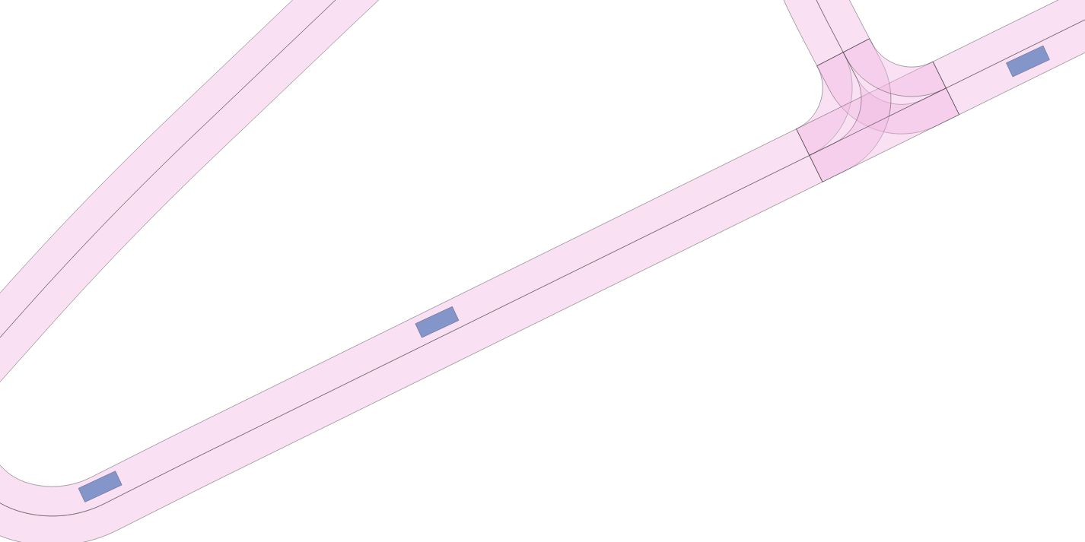
Lanelet
Oncoming vehicle
Parked vehicle
Ego vehicle

Slide 10
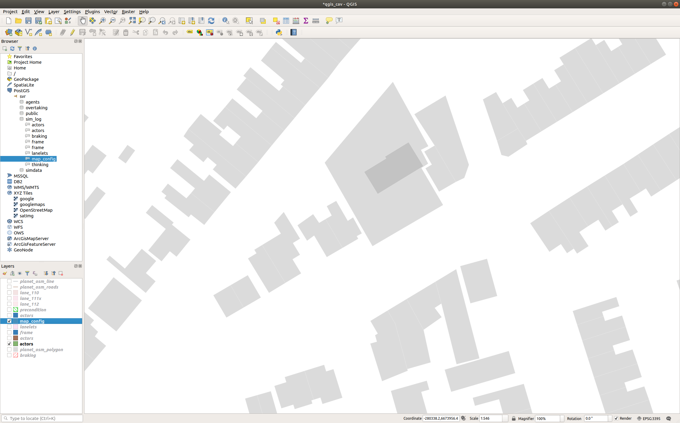
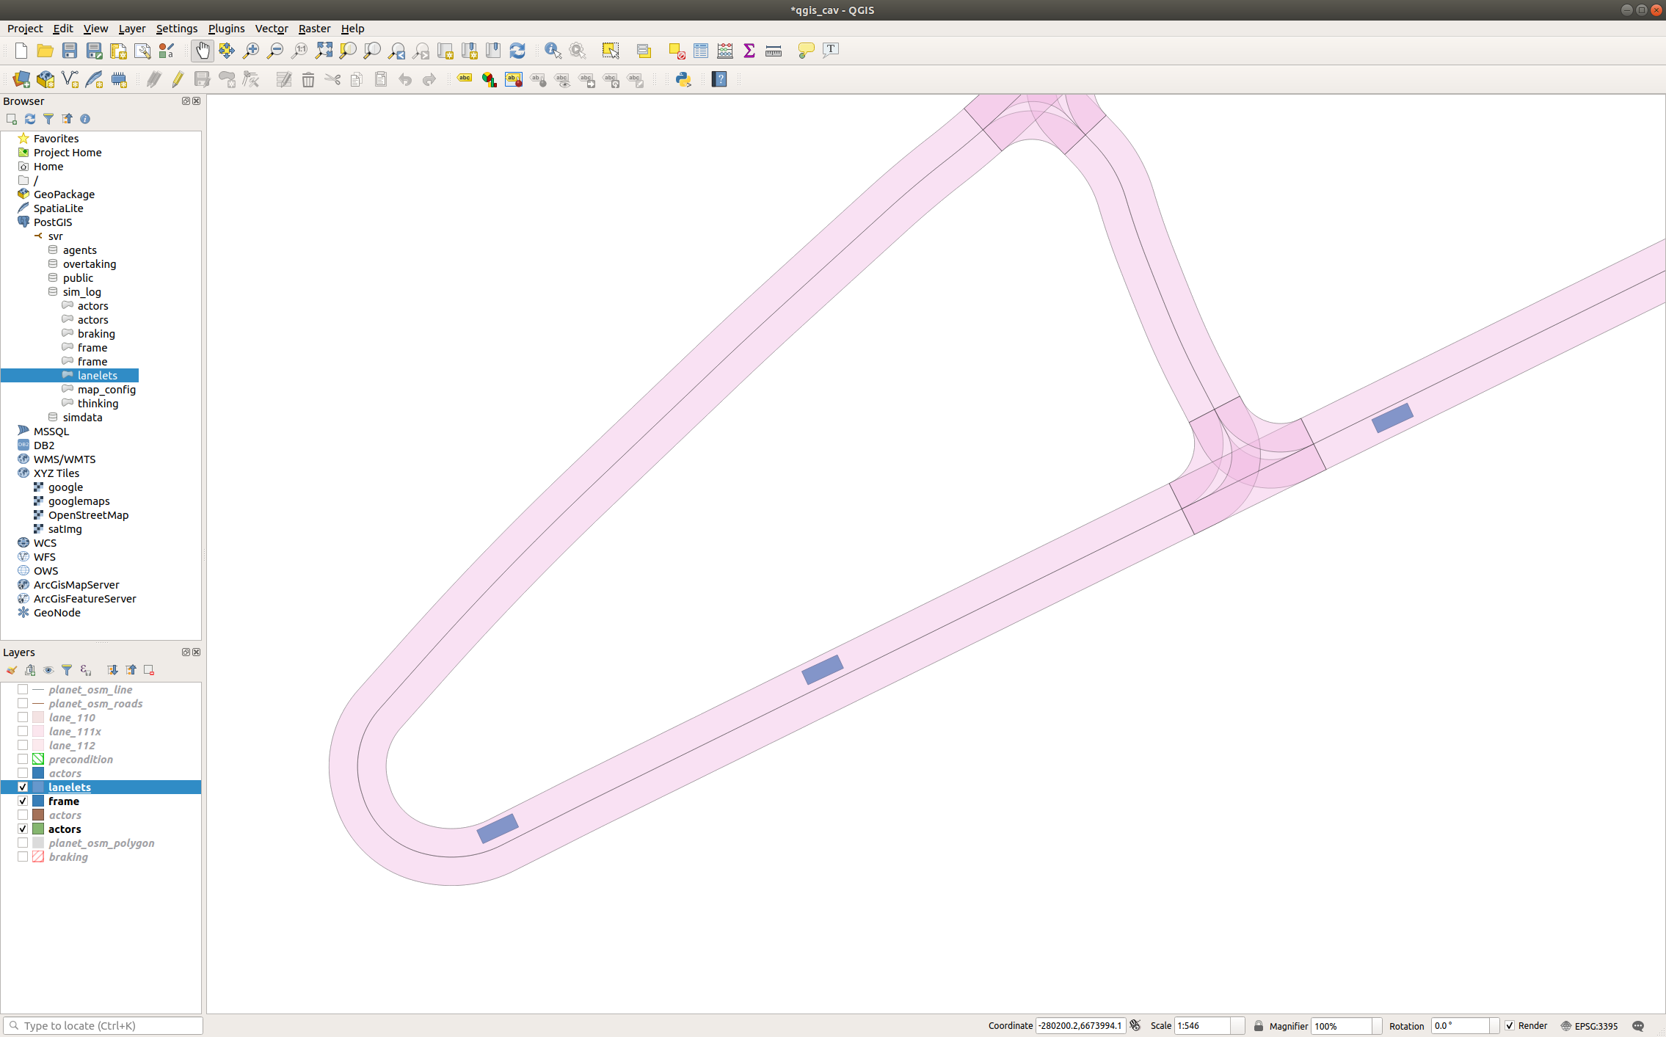
Lanelet
Oncoming vehicle
Parked vehicle
AV

